Slide 1
Capstone EDA Project
Telecom Churn Analysis

Slide 2
Index
Business
Business Problem
Objective
Analysis based on factors of the data
Challenges
Conclusion
Ways to ensure customer retention

Slide 3
Business
Orange S.A., formerly France Télécom S.A., is a French multinational telecommunications corporation.
We have dataset of the company which consist of cleaned customer activity data

Slide 4
Business Problem
Customer churn is the biggest problem for any company, it is important to analyse the data and get solution for it .
Telecom companies have many competitors so customer have many options to switch from one service provider to another. Because of which, they have high churn rate.
We have customer churn data of the company and we need to explore and analyse it to meet our goal and retain maximum number of customers.

Slide 5
Objective
Finding relation between customer churn and other factors
As retaining customers is cheaper than getting new customers from market, we will be focusing on ways to retain the existing customers
New plans for customer or improvising the existing plans that we have as per the factor which influence customer churn
Reducing customer churn

Slide 6
Summary of data
We have 3333 rows and 20 columns with non null values
Out of 20 variables(columns), 1 variable is dependent and remaining 19 are independent variables.

Slide 7
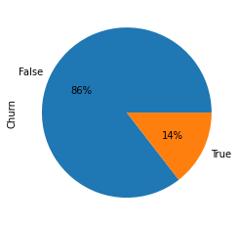
Analysis
We can see that around 14% of Customer Churn is there.

Slide 8
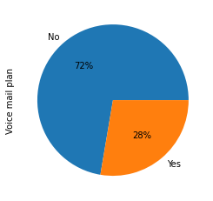
Analysis
We can see that around 28% of customer subscribed for Voice mail plan.

Slide 9
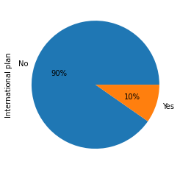
Analysis
We can see that around 10% of customer subscribed for International plan.

Slide 10
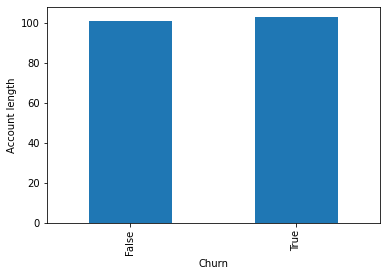
Analysis
Finding relation between numerical independent variables and dependent variable ’Churn’.
We can see that Account length does not affect customer churn much.

Slide 11
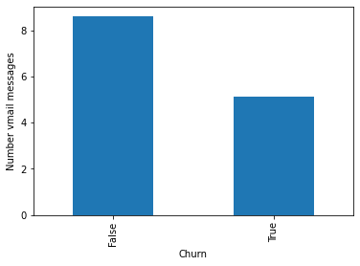
Analysis
Average v-mail by Customer churns were lesser.

Slide 12
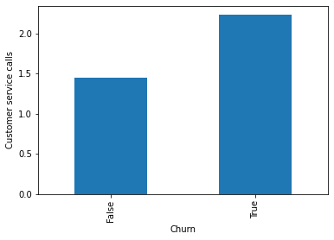
Analysis
Customer churns were trying to take customer service more
Total day mins,Total eve mins, Total night mins and Total intl mins of customer churn are high. -next slide

Slide 13
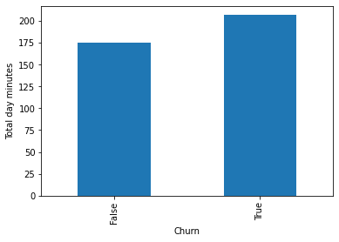
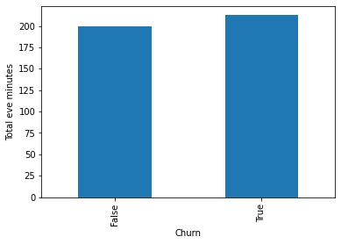
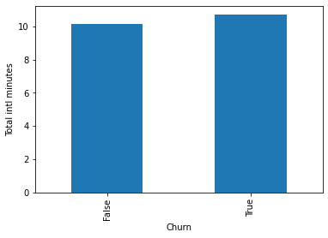
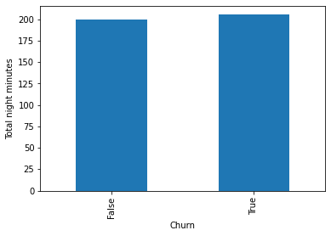
Analysis

Slide 14
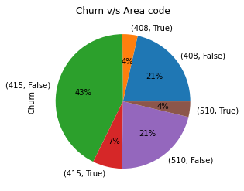
Analysis
Finding relation between categorical independent variables and dependent variable ’Churn’.
We can see that 50% of our customers were from area code 415 out of which 7% are customer churn where as 25% are from 408 and same from 510 and we have 4% of customer churn from both of the area.

Slide 15
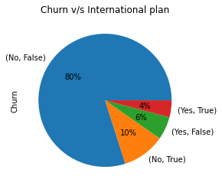
Analysis
Now international plan v/s churn
We can see that 10% of customer had subscribed for international plan out of which 4% are customer churn(i.e, 40% of international plan subscriber)

Slide 16
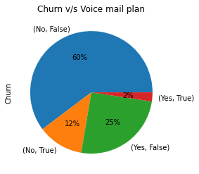
Analysis
V-mail plan v/s churn
27% or customer subscribed for v-mail and 2% of them were customer churn(i.e, around 8 % of v-mail subscriber)

Slide 17
Challenges
Difficulty while understanding the data at first.
Difficulty while plotting graph to find relationship between different features

Slide 18
Conclusion
Account length does not affect customer churn much
Customer churned were calling customer service more
Average daily call mins of customer churn were high
8% v-mail subscribers are customer churn
40% international subscriber are customer churn
We have maximum customers from area code 415.

Slide 19
Ways to ensure customer retention
Improve customer service
Take feedback of customer service
Try to solve customer issues asap
Introducing new plan for customer who talking for longer duration
We can introduce special plan for Area code from where we are getting high number of customers to retain them and also we can try to get more customers from other areas by introducing plans for new customers
Make changes in international and v-mail plans
If we find customer is inactive or any other reason to go churn we can give special offer to retain the customer
Always keep details of competitors where our customers are going and there services
If customer if leaving our service try to take feedback from them and improve our service accordingly

